Slide 1



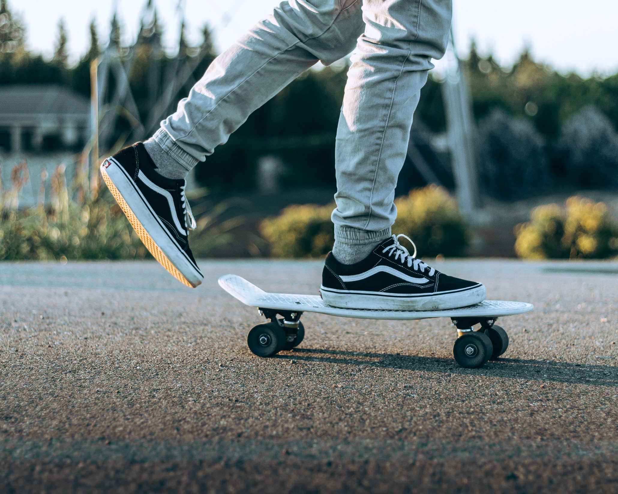





Top Brand Shopping
Login
About ELJAY Enterprise
Help
ELJAY
Brand Name, Model, Colorway
$0.00
ENTERPRISE
FOOTWEAR
SHIRTS
BACKPACKS
WATCHES
VANS OLD SKOOL
One of the best skateboarding shoes
Available in variety of models and sizes, for men and women. Starting at
$80 ONLY
TAKE A LOOK
© 2019 ELJAY ENTERPRISE™. All Rights Reserved
Follow us on:

